Slide 1
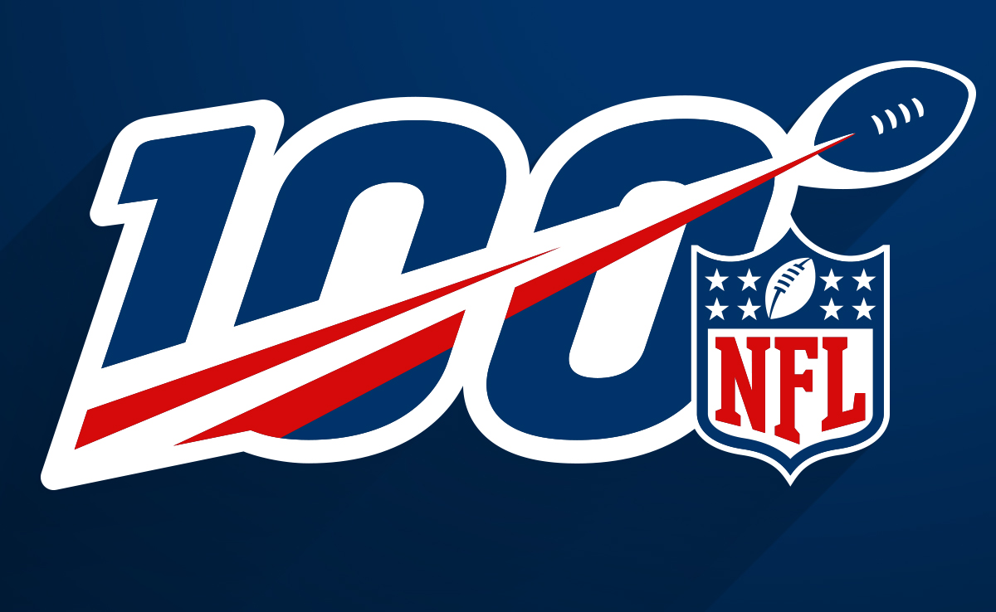

Team: NaN
NFL Offensive Play Prediction
Team: NaN

Slide 2








Data Analytics – Predict National Football League offensive play types and yards
1. Overview
Context
Project Objectives
117,738
Plays for rush/pass analysis
(2016-2019 seasons)
509,762
Plays with rush yards data for rush yards prediction from 2017 season
$2.86B
Average market value of NFL teams for season 18/19, with most valuable team Dallas Cowboys at $5.5B
The main objective of our project is to predict the National Football League offensive play types (rush/pass) and yards of rush plays.
We combined play by play data of 2016-2019 seasons and team stats to form a dataset for further analysis, and then explored data to develop, compare, and select predictive models on both rush/pass prediction and yards prediction.
43
Features for rush/pass analysis (quarter, yards-to-go, etc.)
90
Features for rush yards analysis (quarter, yards-to-go, etc.)
Benefits of the project
In-game Decision-making: Optimize teams’ in-game defensive/offensive play decisions and tactics by improving the prediction accuracy of offensive play types and their possible outcomes
Team Management: Redesign the training programs to assist players in increasing reaction speed and gaming-reading abilities

Slide 3
Data Analytics – Predict National Football League offensive play types and yards
2. Data Collection & Methodology
Data Collection
Methodology
A. Rush/pass Data
B. Rush Play Yards Data
For both rush/pass play type prediction and rush play yards prediction, we both build additional intensive features aiming at capturing more accurate real-time situations in each game and more team-related factors (e.g. tendency and strengths) to better predict the behavior of teams in the next play.
Once data is cleaned and normalized, we try different machine learning models and choose the one with best prediction outcomes.
Data Source
NFLsavant.com
Web Scraping
Pro-football-reference.com
Data Cleaning
Standardize team names
Remove null data
Compute Time Remaining to find real time score difference
Select Pass, Rush, Scramble plays
Compute Team Ranks on multiple offense and defense categories(based on distributions)
Data Source
Kaggle NFL Big Data Bowl
Web scraping
Pro-football-reference.com
Data Cleaning
Standardized team names
Fixed typos, extract relevant info from categorical variables and standardize categories
Constructed new features based on raw data (e.g. player BMI, age)
Compute Team Ranks on multiple offense and defense categories(based on distributions)
1
Rush/pass models:
Logistic regression
Linear discriminant analysis
Random forests
Gradient boosting machine
XGBoosting
K-nearest neighbors
Neural networks
B. Rush yards models:
Linear Regression
Regression Tree
Random Forest
Bootstrapping
XGBoosting
LightGBM
Neural networks
2

Slide 4
Data Analytics – Predict National Football League offensive play types and yards
3.1 Data Structures
Data Structure – Rush/ Pass Prediction
Data Structure – Rush Yards Prediction
Season
IsFumble
Home/Visitor Teams
Players Info
Game Info
Other Info
Game Info
Date
YardLine
Other Info
Season
Rusher
Quarter
IsPass
Date
Direction
Yards-to-go
IsRush
Game State
Quarter
Weather
Play Stats
Game State
Down
InIncomplete
Play Stats
Distance
Team Stats
...
...
Down
Stadium Type
...
...
Feature Engineering
Feature Engineering
Remaining
PointDiff
Possess Team
Off_Pass_Overall_rank
Game Clock
Possess Team
Possess/Defense Score
Def_Pass_Overall_rank
Off_Rush_Overall_rank
Def_Rush_Overall_rank
Offense
Off_Rush_Yds
Def_Rush_Yds

Slide 5




Data Analytics – Predict National Football League offensive play types and yards
3.2 Rush / Pass Play Modeling Process
Cross Validation
Hyperparameters Pruning
3
Model
Features Selection
2
1
Description
Distinguish before-play data and after-play data
Generate cumulative data
Run regressions of Y on X and distinguish which are significant
Separately use significant features and all features in the models
Determine which hyperparameters are relatively important, e.g. max_depth and # of trees in R.F., based on our research
Try different combinations of the hyperparameters and choose the best models
Use 10-fold cross validation to obtain a more robust prediction of each models.
Use this average accuracy as model performance indicators
Advantages
Use more features may increase the prediction accuracy, leading to better model performance stats
Very likely to improve prediction accuracy and model performance
Reduce the influence of biased training and testing set split, so the results are more reliable.
Drawbacks
May be too computational costly. Need to trade off between accuracy and computation time.
May be too computational costly. Need to trade off between accuracy and computation time.
Likely to cause collinearity

Slide 6

Data Analytics – Predict National Football League offensive play types – Rush/ Pass
3.3 Rush/ pass prediction results
Accuracies and false negative rates for each model
Model | C.V. Training Accuracy | Test Accuracy | False Negative Rate
Logistic Classifier | 72.00% | 72.29% | 19.71%
Linear Discriminant Analysis (LDA) | 72.05% | 72.11% | 20.29%
Random Forest | 72.85% | 72.69% | 21.03%
Gradient Boosting Machine (GBM) | 73.34% | 73.17% | 21.25%
eXtreme Gradient Boosting (XGB) | 72.91% | 72.% | 20.79%
Findings
• GBM is the most accurate in terms of both training accuracy and test accuracy
• The test accuracies of all the five models are quite close to the training accuracies, representing our models are likely to avoid the overfitting problem.
• We’re more concerned with the false negative rate and list the results. This is because a false negative sample means predict a pass (positive) to be a rush (negative). In NFL games, a formation to defend rush is also less ready to defend a pass. So we don’t want the f.n. to be high. For the models we find there’s no so much difference.

Slide 7
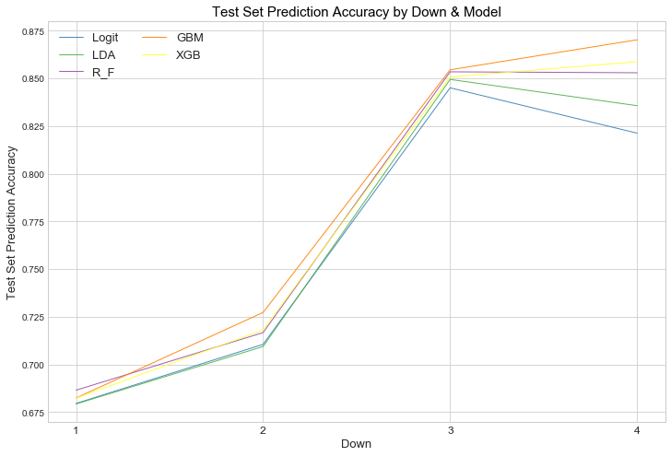
Data Analytics – Predict National Football League offensive play types – Rush/ Pass
3.4 Rush/ pass prediction results —— by quarter
Findings
• We also observe that our accuracy increases on later downs, which may relate to the fact that teams are more concerned about gaining larger yards in the later downs so they can have bigger probability to win the first down. Therefore, the available choices of play are limited.
• We see very little deviation in the performance of our algorithms relative to each other, suggesting that our best models tended to outperform the others across different inputs.

Slide 8
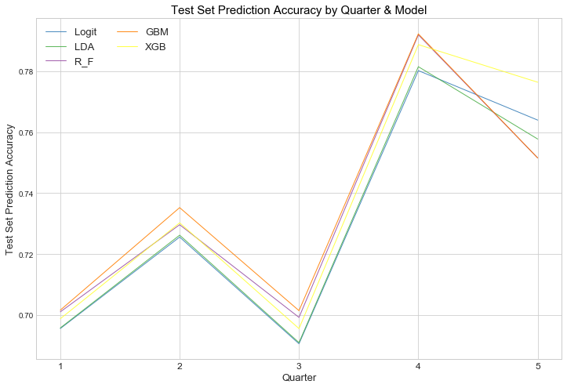
Data Analytics – Predict National Football League offensive play types – Rush/ Pass
3.5 Rush/ pass prediction results —— by down
Findings
• We still see very little deviation in the performance of our algorithms relative to each other, except for GBM in the 4th and 5th quarter. GBM is still the best if we mainly focus on regular game time.
• 2nd and 4th downs are more likely to predict, mainly because they are closer to the end of half-time and the end of game, which largely affect the final result of the game. Specifically, the 4th downs are the most likely to predict.

Slide 9
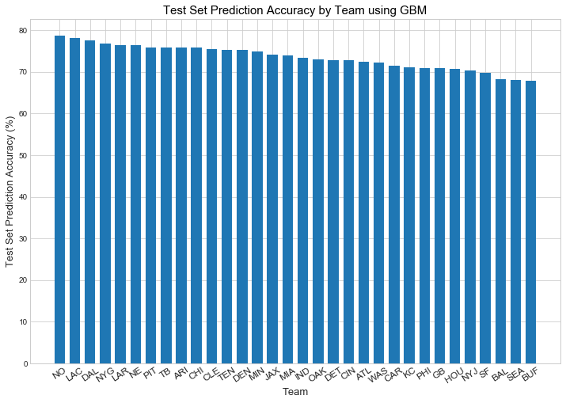
Data Analytics – Predict National Football League offensive play types – Rush/ Pass
3.6 Rush/ pass prediction results —— by team
Findings
• Individual team varies not much in the prediction accuracies, from around 79% to around 68%.
• Some teams with smaller prediction accuracies have more frequent coach team changes than other teams, leading to more frequent game style changes.
• Note: The results are derived using Gradient Boosting Machine.

Slide 10

Data Analytics – Predict National Football League rush yards
4.1 Rush Yards prediction feature engineering & selection
Feature Engineering
1. Constructing new features
2. Incorporating Team Ranks
Compute Duration between TimeSnap and TimeHandoff
Compute YardLeft based on YardLine and FieldPosition
Compute DefendersInTheBox vs Distance
Compute OffenseTeamScoreBeforePlay and DefenseTeamScoreBeforePlay
Compute the offensive team’s and defensive team’s play tendency and rankings on multiple categories (e.g. Offensive team’s rushing attempt, rushing yards/game, Defensive team’s opponent rushing yards/attempt, opponent #rushing TDs)
3. Normalizing Features
4. Standardizing Features
5. Reselecting Features
Convert GameClock into seconds left
Convert PlayerHeight into inches
Convert DOB into age
Converting invalid and rare Offense and Defense Personnels
Reducing Complexity on StadiumType and Turf
Normalize Weather, WindDirection and WindSpeed
Categorical Variables Encoding using BaseNEncoder
Standardized Columns using StandardScaler
• After running each model, modify features to be included based on the Feature Importance plot, repeat these steps until the best set of features is found.

Slide 11
Data Analytics – Predict National Football League rush yards
4.2 Rush Yards prediction model selection
Model | Linear Regression | Regression Tree | Random Forest | Bootstrapping | XGBoost | LightGBM | Neural Network
RMSE (Test Plays) | 5.426 | 5.821 | 3.244 | 3.237 | 2.763 | 2.847 | 3.502
Accuracy (Training Plays) | 0.064 | 0.082 | 0.872 | 0.871 | 0.999 | 0.998 | 0.979
Accuracy (Test Plays) | 0.064 | 0.080 | 0.665 | 0.666 | 0.757 | 0.742 | 0.594
Model Ranking | 7 | 6 | 4 | 3 | 1 | 2 | 5
Best Model |  |  |  |  | √

Slide 12
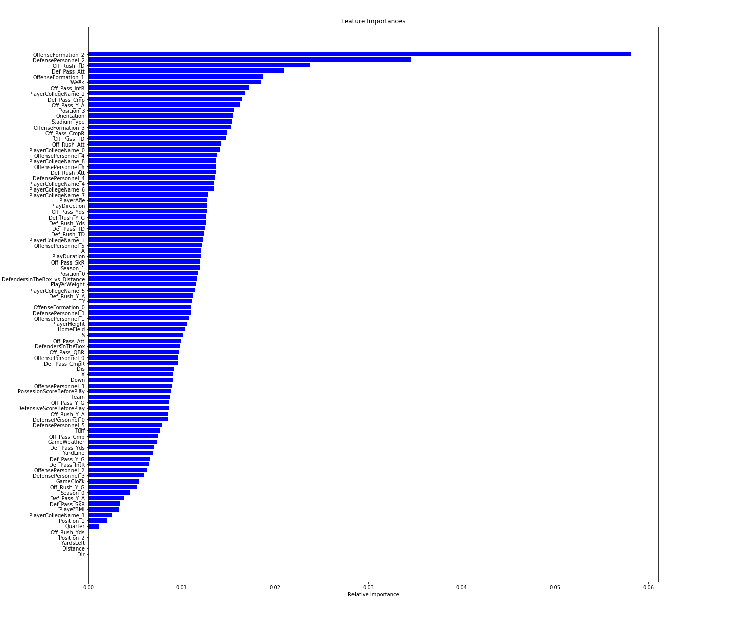
Data Analytics – Predict National Football League rush yards
4.3 Rush Yards prediction model selection

Slide 13
Data Analytics – Predict National Football League offensive play types and yards
5. Business impact
Based on our analysis, we build a user-friendly application for team managers to predict play
Future work: Mix some of the models with better outcomes to obtain new models with higher prediction capabilities.

